Slide 1

Introduction to Stateful Stream Processing with Apache Flink
Ahmad Makki
MSDSF23M22 EngrAhmadMakki@gmail.com
Apache Flink®

Slide 2
Apache Flink: 4G of Big Data

Slide 3


Apache Flink
Apache Flink is a powerful open-source stream processing framework allowing real-time data processing and analysis.
Key Features of Apache Flink
Low latency
High throughput
Stateful
Distributed

Slide 4


What is Apache Flink?
Data Stream Processing
realtime results from data streams
Batch Processing
process static and historic data
Event-driven Applications
data-driven actions and services
Stateful Computations Over Data Streams

Slide 5
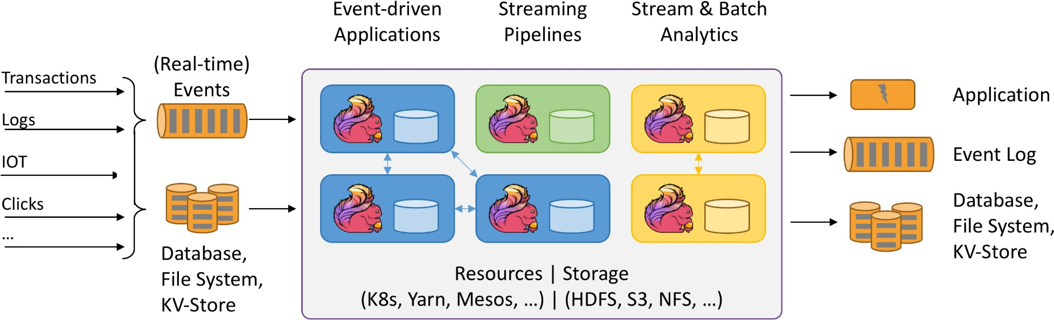
ARCHITECTURE
Architecture and Workflow

Slide 6
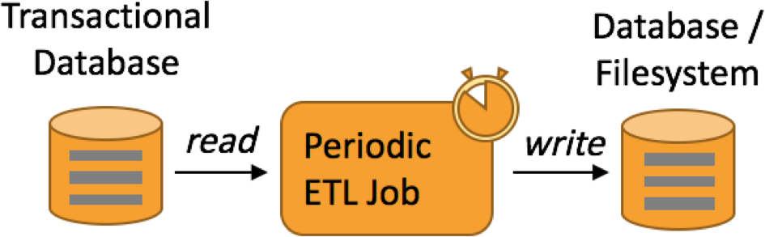
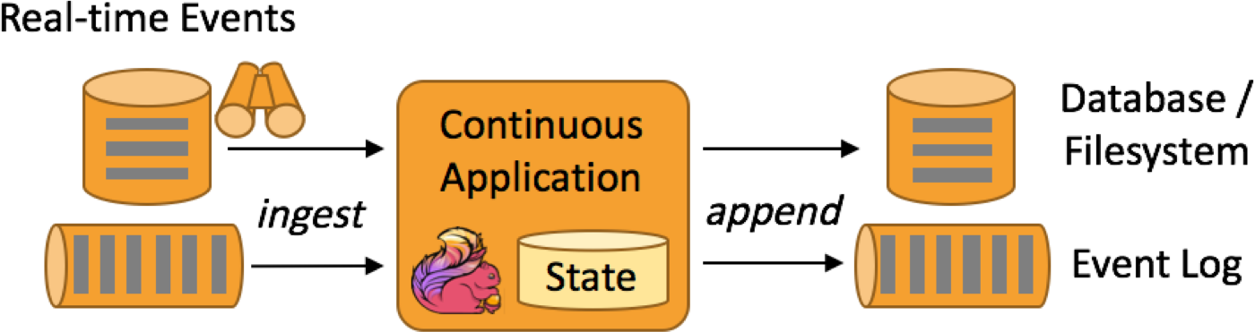
Use Case: Streaming ETL
Periodic ETL is the traditional approach
External tool periodically triggers ETL batch job
Periodic ETL
Data Pipeline / Real-time ETL
Data pipelines continuously move data
Ingestion with low latency
No artificial data boundaries

Slide 7
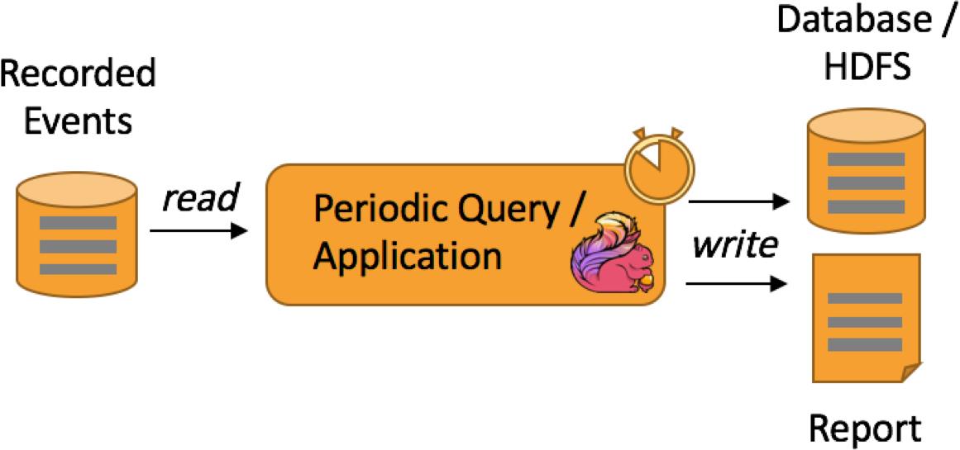
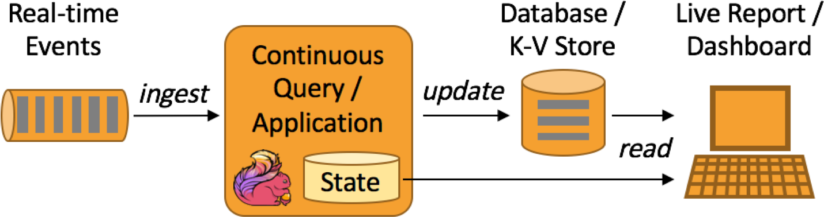
Use Case: Data Analytics
Batch analytics is great for ad-hoc queries
Queries change faster than data
Interactive analytics / prototyping
Batch Analytics
Stream analytics continuously processes data
Data changes faster than queries
Live / low latency results
No Lambda architecture required!
Stream Analytics

Slide 8
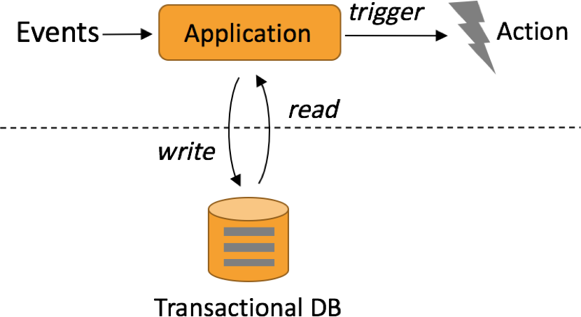
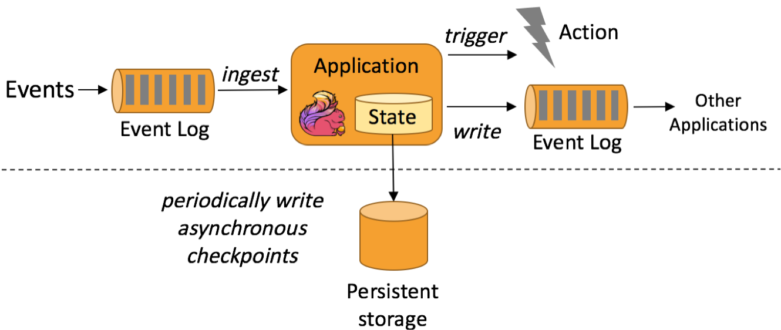
Use Case: Event-driven applications
Traditional application design
Compute & data tier architecture
React to and process events
State is stored in (remote) database
Transactional Application
Event-driven application
State is maintained locally
Guaranteed consistency by periodic state checkpoints
Tight coupling of logic and data
(microservice architecture)
Highly scalable design
Event-driven Application

Slide 9





















Hardened at scale
Details about their use cases and more users are listed on Flink’s website at https://flink.apache.org/poweredby.html

Slide 10
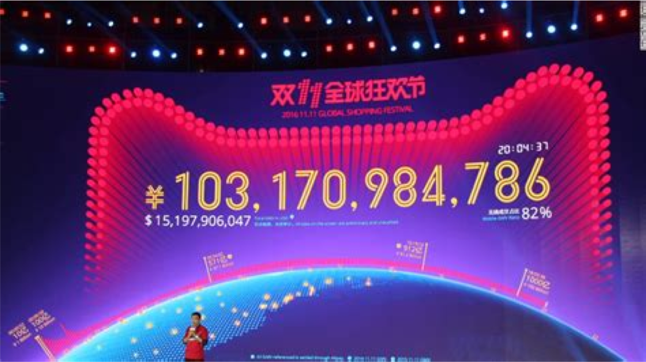
Case Study: Single’s Day
Chinese Shopping Festival
Very high peak load
100s millions records per second
100s thousands payments per
second
10 TBs of managed state
10s thousands of cores
Flink used in various areas in the
process incl. payment, shipping, realtime recommendations and the giant dashboard
References
https://www.ververica.com/blog/singles-day-2018-data-in-a-flink-of-an-eye
https://medium.com/@alitech_2017/how-to-cope-with-peak-data-traffic-on-11-11-the-secrets-of- alibaba-stream-computing-17d5e807980c

Slide 11
Building blocks

Slide 12
The Core Building Blocks
Event Streams
State (Event) Time
Snapshots
consistency with out-of-order data and late data
forking / versioning / time-travel
real-time and hindsight
complex business logic

Slide 13
Stateful Event & Stream Processing
val lines: DataStream[String] = env.addSource(new FlinkKafkaConsumer(…))
Source
val events: DataStream[Event] = lines.map((line) => parse(line))
Transformation
val stats: DataStream[Statistic] = stream
.keyBy("sensor")
.timeWindow(Time.seconds(5))
.sum(new MyAggregationFunction())
Transformation
stats.addSink(new RollingSink(path))
Sink
Streaming Dataflow
Source
Transform
Window (state read/write)
Sink

Slide 14
Stateful Event & Stream Processing
Filter / Transform
State read/write
Source
Sink

Slide 15
Stateful Event & Stream Processing
Scalable embedded state
Access at memory speed & scales with parallel operators

Slide 16
Stateful Event & Stream Processing
Rolling back computation Re-processing
Re-load state
Reset positions in input streams

Slide 17


Time: Different Notions of Time
Event Producer
Message Queue
Flink Data Source
Flink Window Operator
partition 1
partition 2
Event Time
Broker Time
Ingestion Time
Window Processing Time

Slide 18

Time: Event Time Example
Event Time
Episode | Episode | Episode | Episode | Episode | Episode | Episode
IV | V | VI | I | II | III | VII
1977
1980
1983
1999
2002
2005
2015
Processing Time

Slide 19
Recap: The Core Building Blocks
Event Streams State (Event) Time
Snapshots
consistency with out-of-order data and late data
forking / versioning / time-travel
real-time and hindsight
complex business logic

Slide 20
APIs

Slide 21
The APIs
Analytics
Stream SQL
Stream- &
Batch Processing
Table API (dynamic tables)
DataStream API (streams, windows)
22
Stateful Event-Driven Applications
Process Function (events, state, time)

Slide 22
Process Function
class MyFunction extends ProcessFunction[MyEvent, Result] {
// declare state to use in the program
lazy val state: ValueState[CountWithTimestamp] = getRuntimeContext().getState(…)
def processElement(event: MyEvent, ctx: Context, out: Collector[Result]): Unit = {
// work with event and state
(event, state.value) match { … }
out.collect(…) // emit events
state.update(…) // modify state
// schedule a timer callback
ctx.timerService.registerEventTimeTimer(event.timestamp + 500)
}
def onTimer(timestamp: Long, ctx: OnTimerContext, out: Collector[Result]): Unit = {
// handle callback when event-/processing- time instant is reached
}
}

Slide 23
Data Stream API
val lines: DataStream[String] = env.addSource(
new FlinkKafkaConsumer<>(…))
val events: DataStream[Event] = lines.map((line) => parse(line))
val stats: DataStream[Statistic] = stream
.keyBy("sensor")
.timeWindow(Time.seconds(5))
.sum(new MyAggregationFunction())
stats.addSink(new RollingSink(path))

Slide 24
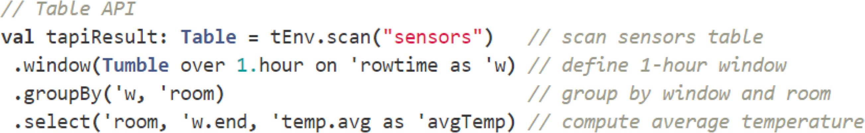
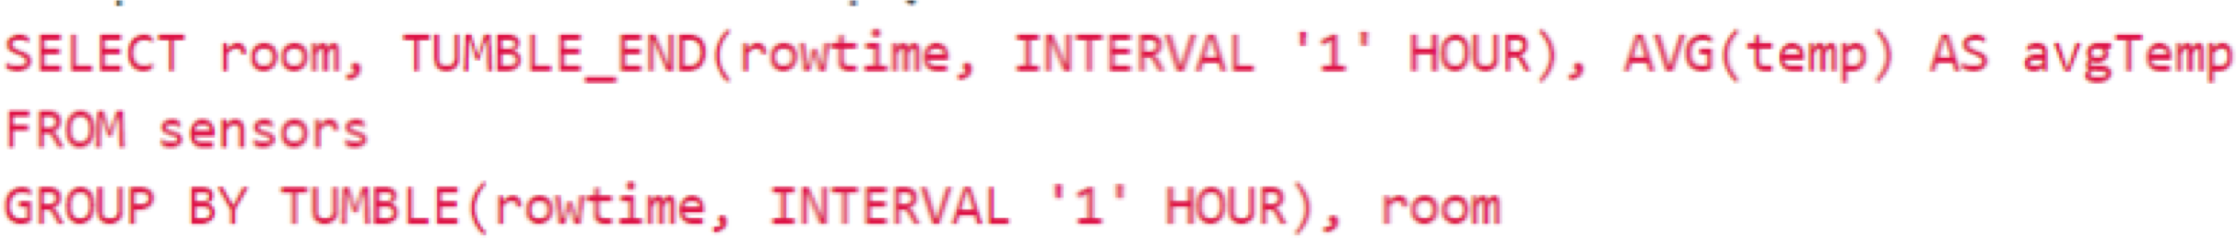
Table API & Stream SQL

Slide 25
Deployment & Integrations

Slide 26
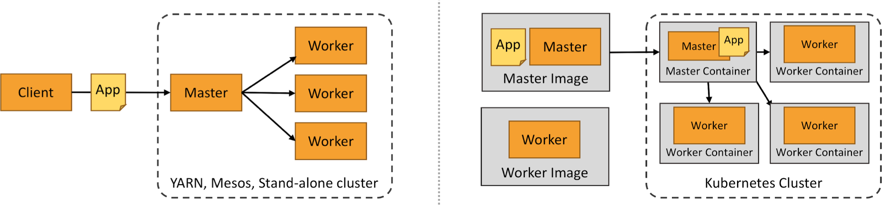







Deployment

Slide 27
Concluding…

Slide 28











Integrations
Event logs:
Kafka, Kinesis, Pulsar*
File systems:
S3, HDFS, NFS, MapR FS, ...
Encodings:
Avro, JSON, CSV, ORC, Parquet
Databases:
JDBC, HCatalog
Key-Value Stores
Cassandra, Elasticsearch, Redis*

Slide 29

Q & A

